Slide 1
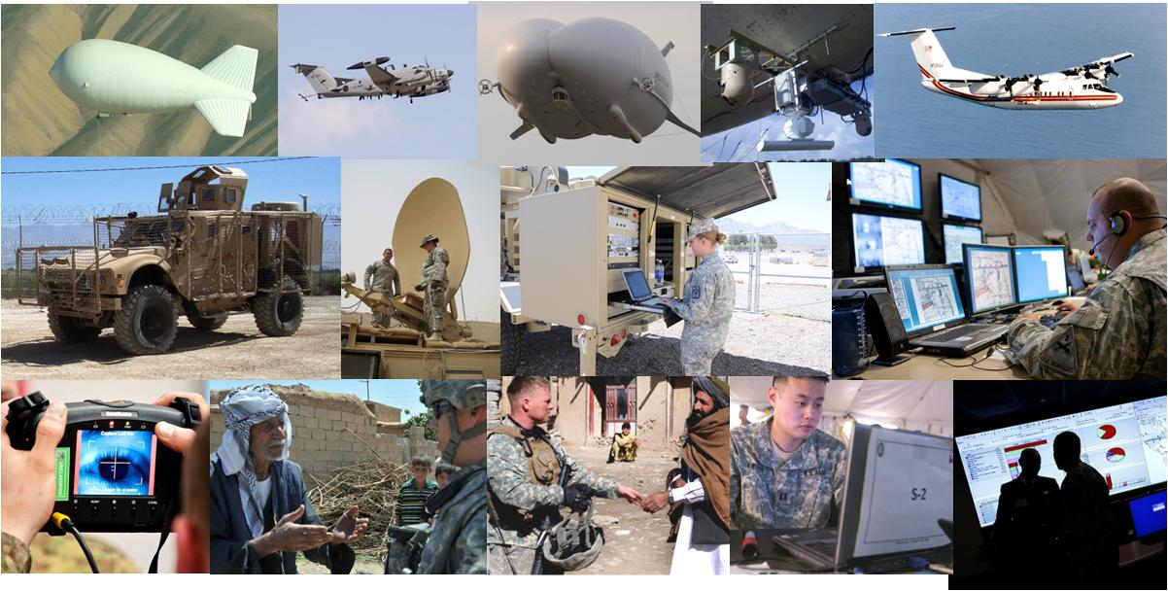
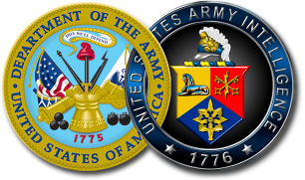
The Operational Environment Through 2030
LTG Mary A. Legere
Deputy Chief of Staff, G-2
2012
Enabling Decisive Operations While Transforming in the Breach

Slide 2
Problem Statement
Problem: Current Threat Assessments Do Not Capture the Future Operational Environment We Will Encounter: Determined, Adaptive Enemies, Multiple Other Actors, Chaotic Conditions
Goal: Create a Compelling Narrative for the Future Operational Environment to Ensure Our Army…
Is Responsive to Our Combatant Commanders’ and Nation’s Requirements
Can Accomplish the Mission--Prevent, Shape, Win--in Any Operational Environment against a Wide Variety of Enemies and Adversaries

Slide 3
BLUF
UNCLASSIFIED
Wide Spectrum of Potential Threats, Challenges, Contingencies
Iran, North Korea, Afghanistan-Pakistan, Multiple Enduring Fault Lines in Middle East, Africa, Central Asia Will Remain Sources of Threats and Challenges
Managing the Relationship with China Only Part of the Problem…U.S. Will Continue To Be Needed as Balancer in Asia, Africa, Middle East
Transnational Terrorists, Insurgents, and Criminal Organizations Will Remain Common Features of the Strategic and Operational Environment
U.S. Remains Globally Powerful, but Freedom of Maneuver Has Narrowed…Greater Need for Support of Strong and Expanding Partnerships
The U.S. Army Must Be Prepared to Operate in a Full Range of Complex Environments
Many Crises Will Be Ambiguous…Threats to U.S. Interests May Only Be Clear after Situation Has Evolved and Deteriorated
If Our Shaping Operations Are Inadequate, U.S. Options May Be Limited
UNCLASSIFIED

Slide 4
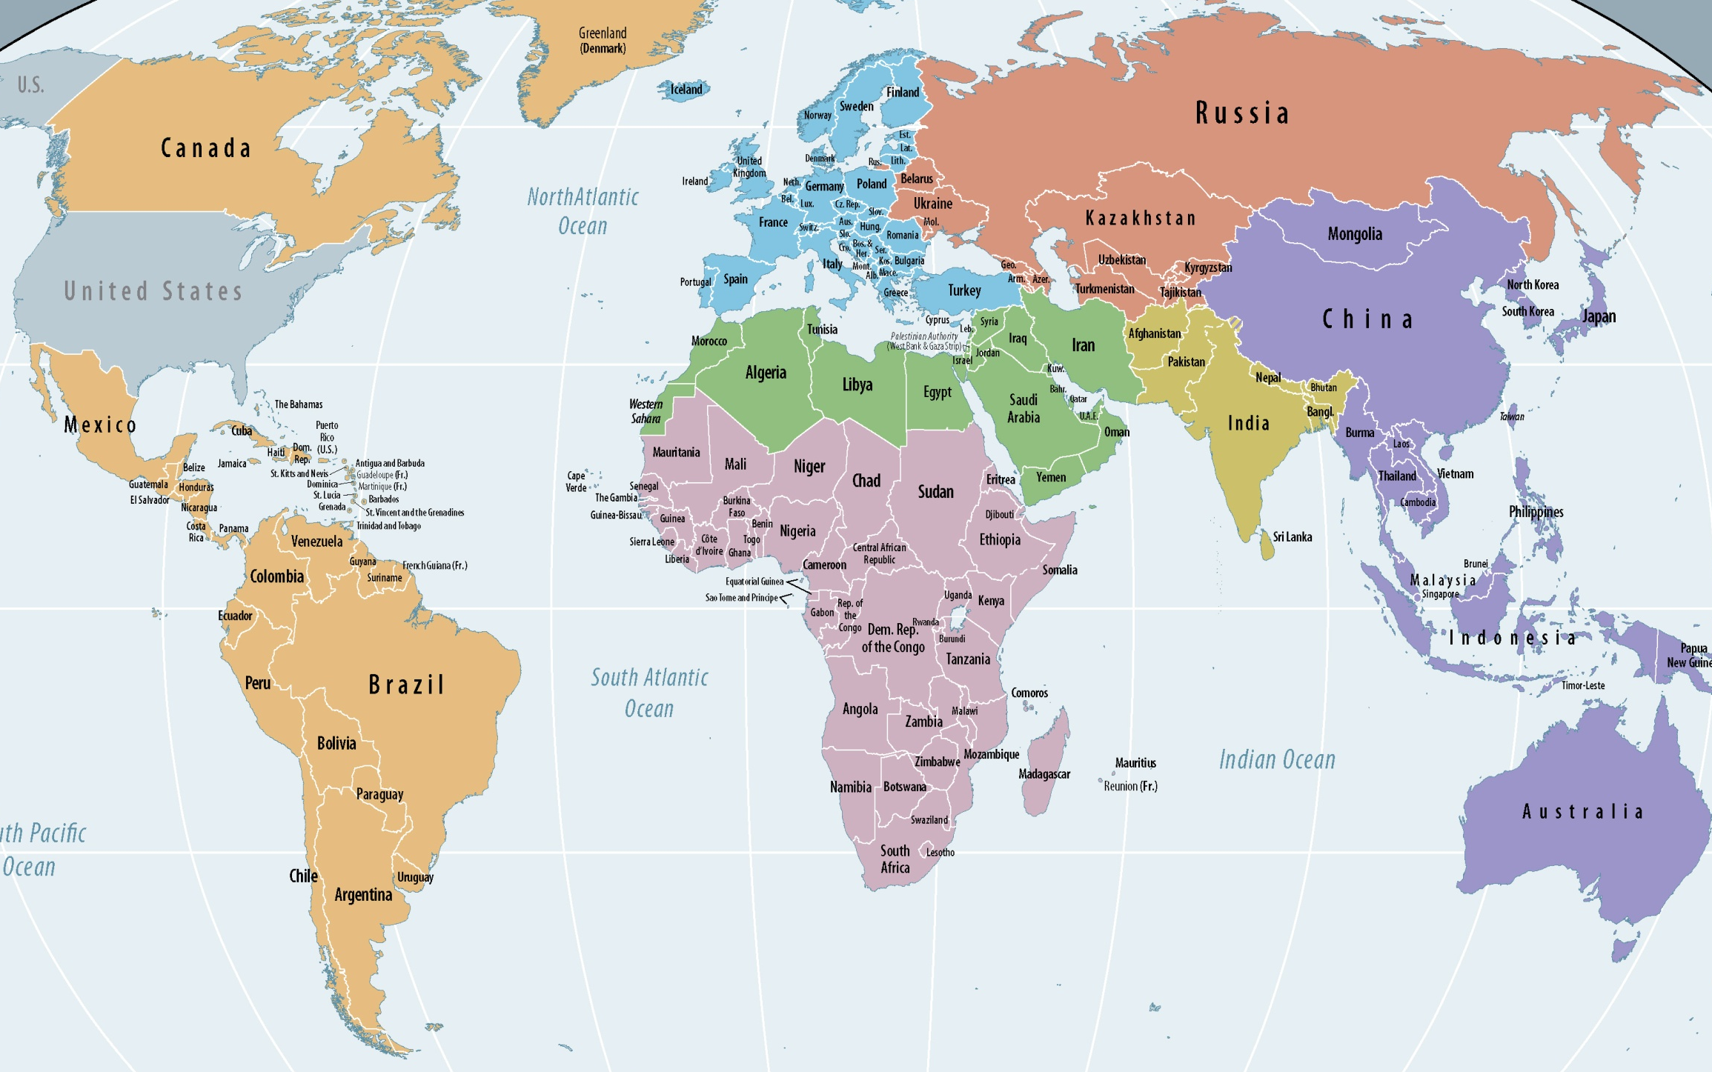
Evolving Global Landscape
UNCLASSIFIED
Europe
Integration & Economic Challenges
Russia
Competitor & Recovering Power
Asia-Pacific
Enduring and Emerging Challenges
Central Asia
Zone
North Korea-Regime Collapse
Middle East
Multiple Internal & External Fault Lines
China
Rising Power
North Korea-South Korea Tensions
India
Rising Power
China-Taiwan Issue
Latin America
Drug Trafficking Influence Zone
South China Sea Tensions
Sub-Saharan Africa
Enduring Governance Crises
Iran
Regional Antagonisms
Afghanistan-
Pakistan
Brazil
Rising Power
Indonesia
Rising Power
Legend
“Rejectionist” State
Primary Strategic Region
Secondary Strategic Region
Friction Zone
Other Strategic Factor
Current Terrorist Presence
Global Issues
Proliferation of Arms, WMD, Cyber Security
Transnational Criminal Organizations
Terrorism, Uneven Economic Growth
Global Financial Vulnerability
Humanitarian/Natural Disasters
Impact of Demographics, Technology
Resource Scarcity (Energy, Water, Food)
Growing Environmental Pressures
Brazil
UNCLASSIFIED

Slide 5
Potential Crises to 2030
Colors Indicate Regional Groupings with Shared Factors
Arctic
Territorial Disputes
Central Asia
Interstate Friction
UNCLASSIFIED
EU Integration
Frictions
Armenia-Azerbaijan Crisis
Russia-Georgia Tensions
Afghanistan
Continuing Insurgency
Cyber Attack on Critical U.S. Infrastructure
Balkans
Instability
North Korea
Regime Collapse
Syria
Civil War
Peacekeeping India/Pakistan
Terrorist WMD Attack
Libya Internal Tensions
Israeli-Palestinian Tensions
North Korea -South Korea Crisis
Iran
Regional Threats, Nuclear
TCO Violence
Cuba - Instability
Egypt Internal Tensions
Pakistan
Internal Tensions
Haiti Crisis
Terrorist Challenge
China-Taiwan Crisis
TCOs Destabilizing Governance
Yemen Instability
SE Asia
Tensions
Terrorist Challenge
Sudan Conflict
Terrorist Challenges
South China Sea Tensions
Venezuela
Instability
Somalia Conflict
Columbia Insurgency
Terrorist Challenge
Sub-Saharan Africa
Widespread Potential Humanitarian Crises, Governance Crises
Piracy
Terrorist Challenge
Peru Insurgency
Range of Threat Actors
Near-Peer State Regional State Failing State Insurgent/Guerrilla/Militia Proxies Terrorists Transnational Criminal Organizations
Global Issues
Proliferation of Arms, WMD, Cyber Security
Transnational Criminal Organizations
Terrorism, Uneven Economic Growth
Global Financial Vulnerability
Humanitarian/Natural Disasters
Impact of Demographics, Technology
Resource Scarcity (Energy, Water, Food)
Growing Environmental Pressures
Large Majority of Crises Stem from Weak Governance
Relationship to U.S. & Allies’ Interests May Not Be Immediately Apparent
Crisis Containment/Resolution May Require US Forces Involvement to Prevent, Shape, Win
Many Crises Are Unfolding Now
UNCLASSIFIED

Slide 6
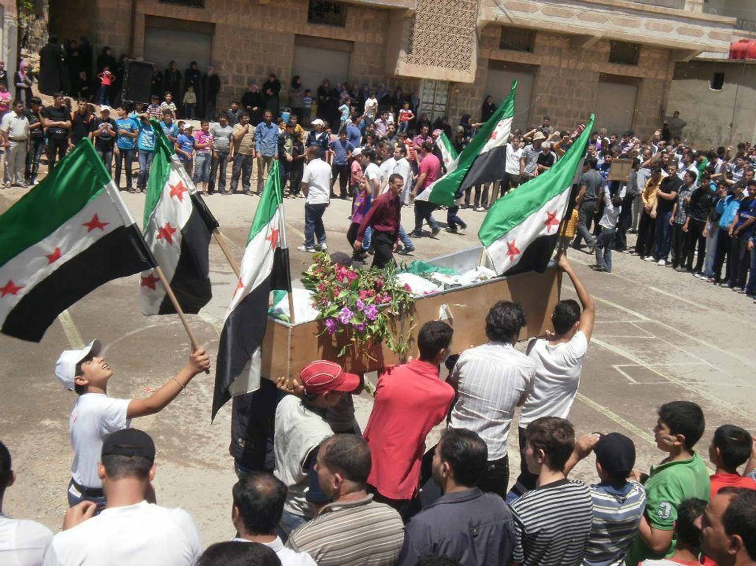
Potential Linkages to U.S. Interests Hypothetical Future Syria Example
Syria in Crisis
Vital U.S. Interests*
Security & Stability of Allies, Partners
Respect for Universal Values
Promote Peace, Security, Opportunity
Open International Economic System
The Spark
Peaceful Popular Protests
Government Responds with Repression
Deteriorating Situation
Armed Opposition
Active Terrorism
Continuous Military Operations
Refugees & IDPs
UN Security Mission
Atrocities
Border Clashes
External Actors
The Flame
Full Civil War with Fractured Territorial Control
Sectarian Militias
Frequent Atrocities
Growing Islamic Extremist Influence with Safe Haven
Instability Spills Over to Neighbors
Border Clashes with Neighbors
Compromised CW Munitions
Polarized Middle East, Global Alignments, Economic Slump
Prevent?
Shape?
Win?
*National Security Strategy, May 2010

Slide 7
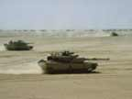
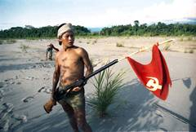
Our Operational Environment
Complex, Lethal, Volatile
Essential Elements of the Complex Environment
Multitude of Independent Actors
Threat, Malicious, and Neutral/Friendly Actors
Technology Enables Effective Action – Violent and Nonviolent – and Rapid Adaptation
Lack of Effective Governance or Rule of Law
Ends Wealth Resources Political authority Influence Sovereignty Identity Legitimacy
Ways Competition Cooperation Conflict
Means Attack the “will” Complexity – Chaotic Conditions – Anti-access Asymmetry
Characteristics
Lethal Well Armed Technology Proliferates to Many Non-linear Relationship between Economic and Military Power
Persistent Victory Ill Defined Blurred Transitions, e.g. Conflict to Post Conflict. Unexpected Friction
Asymmetric Sidestep US Preferred “Way of War” Deny ISR & Strike Options Exploit Cyber Unforeseen Effects from Actions
Threats
Terrorist
Paramilitary
State Actor
Criminal
Militias
Hybrids
Malicious Actors
Radical Ideologues
Criminals
Opportunists
Competitors
“Neutrals” and Friendlies
Media
Population?
NGOs
Coalition Partners
Notes:
The way that we look at the operational environment is that it is extremely complex.
The essential elements of the complex environment are, first, a multitude of independent actors with little central control.
These actors will usually include clear threat actors of many types; malicious actors, who use selective violence to exploit the situation; and so-called “neutral” and friendly actors, meaning they do not regularly employ violence.
Second, modern technology, from IEDs to social media, enables even small groups to mobilize, rapidly adapt, and effectively advance their agenda – peacefully or otherwise.
And the third element is usually a lack of effective governance – where the rule of law has failed or is seriously challenged by most of the actors.
We illustrate the complexity of the various actors with the cloud diagram. Above the dividing line are the mainly violent actors. Below the line are the mainly nonviolent actors. The term “neutral” here simply means a group that neither strongly opposes nor strongly supports our objectives in the situation – in reality, true “neutrals” will be rare. Population elements, for example, may well be the supportive base for threat or malicious actors. Actors can migrate upward or downward. The actors pictured here are just examples – many others could be added. A real world situation is likely to be even more complex than this diagram.
To appreciate the full complexity of the environment, however, we need to go another level: that of ends, ways, and means.
Each actor in this complex environment has its own agenda. It seeks to achieve an “end”, such as these listed here. Depending on its resources and worldview, the actor will choose a “way” – either violent or nonviolent. These two choices largely determine whether an actor is a threat, malicious, or neutral/friendly. The upshot is that the complex environment is a welter of competing and conflicting, compatible and incompatible agendas.
From our standpoint, there will be no ideal choices amongst all these agendas. Every choice, even the best option, will have predictable pushback as well as unintended consequences.
All actors have some choice of “means” for pushing their agendas. What concerns us here are the violent actors – the threat as well as the malicious. In most cases, the means will be a variation on attacking our “will” – the assumption being that we are casualty averse and lack persistence.
Threat actors, furthermore, will typically share several key characteristics. They can be highly lethal. Motivated by their own existential predicament, they can be very persistent. And, knowing our strengths, they will strive to impose their own preferred way of war on us.
We have been trying to codify this environment in a relatively compact definition statement…

Slide 8
The Global Operational Environment Proposed Definition
The global operational environment is complex, characterized by a multitude of actors presenting a wide range of possible threats under conditions of uncertainty and chaos. Adversaries' regular forces, irregulars, our coalition partners, criminals, refugees, NGOs and others intermingle in this environment and interact in many ways. Each of these actors may have an agenda, often at odds with our objectives, those of other actors, and those of the existing political order. Besides a broad range of readily available conventional weapons, threats and malign forces can select from an array of affordable technologies, adapting them to create unexpected and lethal weapons. Social media will enable even small groups to mobilize people and resources in ways that can quickly constrain or disrupt operations. This complex operating environment will continuously evolve as conditions change.
Essential Elements of the Complex Environment
Multitude of Independent Actors
Threat
Malicious
Neutral/Friendly
Technology Enabling Effective Action – Violent and Nonviolent – and Rapid Adaptation
Fragile or Ineffective Governance
Notes:
…and here is our proposed definition, worked out between TRADOC and my staff.
You can see how the individual elements on the left link to specific portions of the definition.
At best, however, the definition is a guide, not a narrow, inflexible set of parameters; tremendous variation is possible within each of the elements.
I welcome your comments on this proposed definition.
Now, how do we go from this conceptual description to reality and apply the definition to the world insofar as we can project it over the next decade or two and apply our description…?

Slide 9
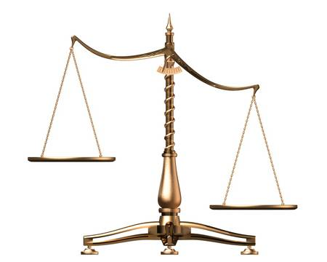
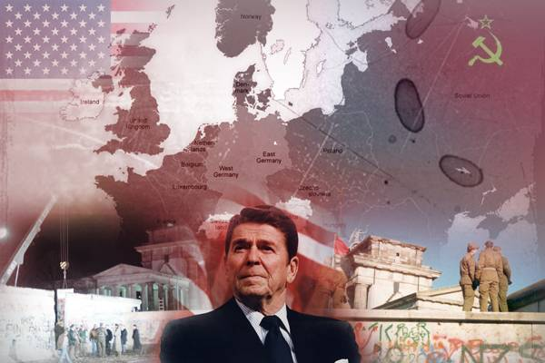
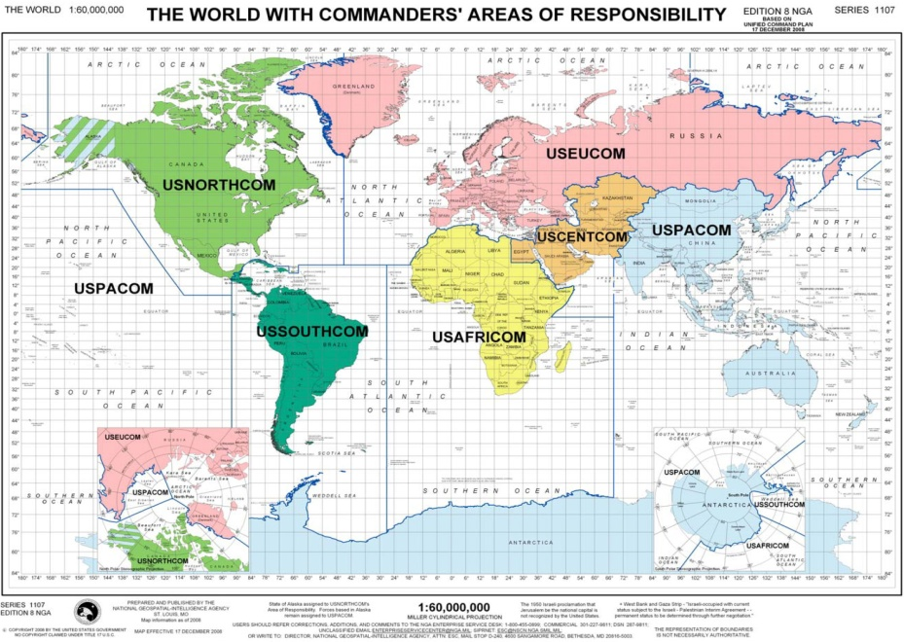
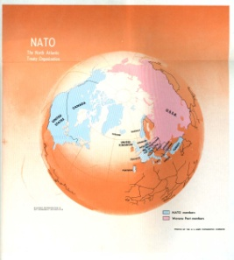
Evolving Global Power Balance and Implications
We Are Confronted by a Wide Spectrum of Potential Threats, Challenges, Contingencies
Range of Economic and Geopolitical Issues Contribute to a Highly Complex Security Environment -- Potential Crises are Not Hypothetical – but Unfolding Now
Iran, North Korea , Afghanistan-Pakistan, Multiple Enduring Fault Lines in Middle East, Africa, Central Asia Will Remain Sources of Threats and Challenges
Managing the Relationship With China – Only A Part of the Problem; U.S. Will Continue to be Needed as Balancer in Asia, Africa, Middle East
Transnational Terrorists, Insurgents, and Criminal Organizations Will Remain Common Features of the Strategic and Operational Environments
US Remains Globally Powerful, but Less So--Freedom of Maneuver Has Narrowed…Requires More Shaping in Concert with Strong and Expanding Partnerships
U.S. Army Must Be Prepared to Operate in a Full Range of Complex Environments
Many Crises Will Be Ambiguous…Threats to Our Interests Only Clear after Situation Has Evolved
Early Engagement, Shaping, Regional Presence, Prevention… Critical to Global Stability, Security… Inadequate Shaping Will Limit Options

Slide 10
The Army’s Challenge Remaining Globally Engaged – Left of the Bang
“Our Army is the Nation's Force of Decisive
Action, A Relevant and Highly Effective Force For
a Wide Range of Missions.”
“While We Cannot Predict the Future of Our Increasingly Uncertain and Complex Strategic Environment, We Can Be Certain that Our Nation Will Continue to Call on America’s Army.”
GEN Raymond T. Odierno
Can We Recognize Critical Fault Lines and Emerging Threats?
Are We Sufficiently Engaged to Defuse Conflict Before Crisis?
Are We Setting Conditions to Avoid the Fight?
Do We Value Deterrence?
Are We Structured for Phase 0-4 Employment?
Will We be Ready When Called?
The Future Is Here Today. What Should We Be Preparing for Now?
Notes:
The difference between Syria and Egypt is we had decades of security assistance and billions of dollars in aid to Egypt and thus our ability to influence was much greater.
Those were possible scenarios but the future is now. There are already many situations around the globe that we should be shaping.
The relevance to the Army is obvious.
Do we believe in Phase Zero and One?
In an era of budget cuts we must retain a full spectrum force that is ready to go now.
The Air Force and Navy are pivoting toward the Pacific, but the Army never left .

Slide 11
Discussion
Enabling Decisive Operations While Transforming in the Breach

