Slide 1

DCIPS
PAY BANDS
“IA”
DCIPS
GRADES
“GG”

Slide 2
Current Versus New Position
◆ All Army DCIPS banded positions will be transitioned to DCIPS grades effective 25 March 2012. In all cases, Army DCIPS employees currently assigned to a pay band identified by pay plan “IA” will change to a DCIPS grade -- pay plan “GG”. During transition, the employee's CURRENT position is aligned for the new DCIPS graded system.
This tutorial describes transition impacts leading up to and resulting from transition from a DCIPS banded environment to a DCIPS graded environment. These changes are based upon revised Department of Defense Instruction (DoDI) 1400.25 (volumes 2001-2015) and supplemental Army Policy Volumes (AP-V’s) 2001-2015, to be published prior to transition.
Most of the information depicted in this tutorial are anticipated DCIPS policy changes but are solely predecisional until final policies are signed. Furthermore, this tutorial is a summary of changes and not inclusive of all DCIPS policy changes anticipated.

Slide 3
Why are we Transitioning DCIPS?
◆ The Secretary of Defense made the decision to transition all Defense Intelligence employees currently in DCIPS pay bands, with the exception of those at National Geospatial-Intelligence Agency (NGA), to DCIPS Grades. His decision was based on input from Component and Department leadership, the Director of National Intelligence, the Director of the Office of Personnel Management, and our congressional oversight committees.
The Secretary’s decision does not represent abandonment of DCIPS and its fundamental tenets of unifying the Defense Intelligence Enterprise within a performance driven culture. However, excluding NGA, future Defense Intelligence base pay increases will not be directly linked to performance and employees will be aligned to the DCIPS graded structure.
The heart of the DCIPS program will stay intact, including the occupational structure, common performance management system, and bonuses tied to performance.
At transition we will implement USD(I)’s enabling instructions based on NAPA recommendations for continually improving DCIPS.

Slide 4
Alignment from Band Levels to DCIPS Grades
IA to GG
Alignment Decisions

Slide 5
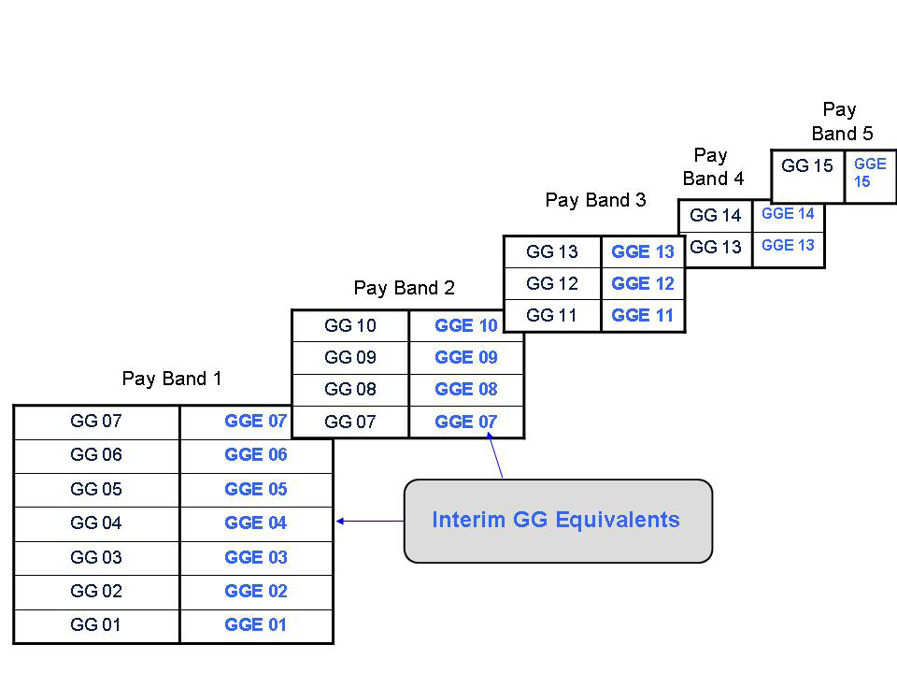
Upon Transition the GG Equivalent (GGE) will NO Longer be Used
The GGE will not be used to determine the grade of base salary. The GGE was used to identify the waiting period for the periodic increase.)

Slide 6
In Determining the DCIPS Grade: Alignment (Classification) is the key
Mission Category
Work Category
Work Level
Ia gg
Grade

Slide 7
The Position Alignment Process
MISSION CATEGORY
ENTERPRISE MANAGEMENT AND SUPPORT
MISSION MANAGEMENT
WORK CATEGORY
WORK LEVEL
ENTRY/DEVELOPMENTAL
GRADE
GG-07 STEP 1 THRU GG-15 STEP 10
OCCUPATIONAL SERIES
TECH/ADMIN
PROFESSIONAL
SUPERVISORY/MANAGEMENT
132
FULL PERFORMANCE
SENIOR
EXPERT

Slide 8


Slide 9
KEY POINTS
Commands will identify an authorizing official who will have certification authority for assigning a grade for each position according to Appendix C of the Total Army Comprehensive DCIPS Transition Plan. This is in alignment with page 10 of Appendix C.
Supervisors will provide employees with a notification letter of their assigned grade prior to transitioning

Slide 10
KEY POINTS
The Elements of the DCIPS occupational structure will remain: Each position will still be aligned to the mission category, work category, and work level
Army will follow the DCIPS grading standard occupational structure in Army Policy Volume (AP-V) 2007 but employee positions will still be aligned to a work level

Slide 11
Alignment of Salary with DCIPS Grades

Slide 12
Alignment of Salary to Grade and Step
I was a IA-03 and my pay is not on a grade and step.
$ 60,274
$ 68,599
$ 78,355
Does the employee’s salary fit between step 1 and 10 of the GG Grade? If so, the salary will be aligned to a step up to STEP 10.

Slide 13
Base Salary will be Aligned to a Step within the Grade Determined – If between steps, a bump up*
Grade | Step 1 | Step 2 | Step 3 | Step 4 | Step 5 | Step 6 | Step 7 | Step 8 | Step 9 | Step 10 | WGI
15 | $99,628 | $102,949 | $106,270 | $109,591 | $112,912 | $116,233 | $119,554 | $122,875 | $126,196 | $129,517 | $3,321
14 | $84,697 | $87,520 | $90,343 | $93,166 | $95,989 | $98,812 | $101,635 | $104,458 | $107,281 | $110,104 | $2,823
13 | $71,674 | $74,063 | $76,452 | $78,841 | $81,230 | $83,619 | $86,008 | $88,397 | $90,786 | $93,175 | $2,389
12 | $60,274 | $62,283 | $64,292 | $66,301 | $68,310 | $70,319 | $72,328 | $74,337 | $76,346 | $78,355 | $2,009
11 | $50,287 | $51,963 | $53,639 | $55,315 | $56,991 | $58,667 | $60,343 | $62,019 | $63,695 | $65,371 | $1,676
10 | $45,771 | $47,297 | $48,823 | $50,349 | $51,875 | $53,401 | $54,927 | $56,453 | $57,979 | $59,505 | $1,526
9 | $41,563 | $42,948 | $44,333 | $45,718 | $47,103 | $48,488 | $49,873 | $51,258 | $52,643 | $56,798 | $1,385
8 | $37,631 | $38,885 | $40,139 | $41,393 | $42,647 | $43,901 | $45,155 | $46,409 | $47,663 | $48,917 | $1,254
7 | $33,979 | $35,112 | $36,245 | $37,378 | $38,511 | $39,644 | $40,777 | $41,910 | $43,043 | $44,176 | $1,133
6 | $30,577 | $31,596 | $32,615 | $33,634 | $34,653 | $35,672 | $36,691 | $37,710 | $38,729 | $39,748 | $1,019
5 | $27,431 | $28,345 | $29,259 | $30,173 | $31,087 | $32,001 | $32,915 | $33,829 | $34,743 | $35,657 | $914
4 | $24,518 | $25,335 | $26,152 | $26,969 | $27,786 | $28,603 | $29,420 | $30,237 | $31,054 | $31,871 | $817
3 | $21,840 | $22,568 | $23,296 | $24,024 | $24,752 | $25,480 | $26,208 | $26,936 | $27,664 | $28,392 | $728
2 | $20,017 | $20,493 | $21,155 | $21,717 | $21,961 | $22,607 | $23,253 | $23,899 | $24,545 | $25,191 | $646
1 | $17,803 | $18,398 | $18,990 | $19,579 | $20,171 | $20,519 | $21,104 | $21,694 | $21,717 | $22,269 | $552
*Step 10 & Above – No bump up. (Employees salaries exceeding step 10 will be on pay retention (step 00)

Slide 14
Periodic Increase (PI) under DCIPS bands will be Known as a Within Grade Increase (WGI) under DCIPS Grades
10
$65,723
Waiting period for steps 7 thru 10 is
156 weeks?
9
$63,695
8
$62,019
Waiting period for steps 4 thru 7 is
104 weeks?
7
$60,343
6
$58,667
5
$56,991
Waiting period for steps 1 thru 4 is
52 weeks?
4
$55,315
3
$53,639
2
$51,963
1
$50,287

Slide 15

Waiting Period for WGI & Non-Pay Time
Advancing to Steps… | Waiting Period
2, 3 or 4 | 52 calendar weeks
5, 6 or 7 | 104 calendar weeks
8, 9 or 10 | 156 calendar weeks
Advancing to Steps… | Non-Pay Time Allowed
2, 3 or 4 | 2 workweeks (80 hours)
5, 6 or 7 | 4 workweeks (160 hours)
8, 9 or 10 | 6 workweeks (240 hours)

Slide 16
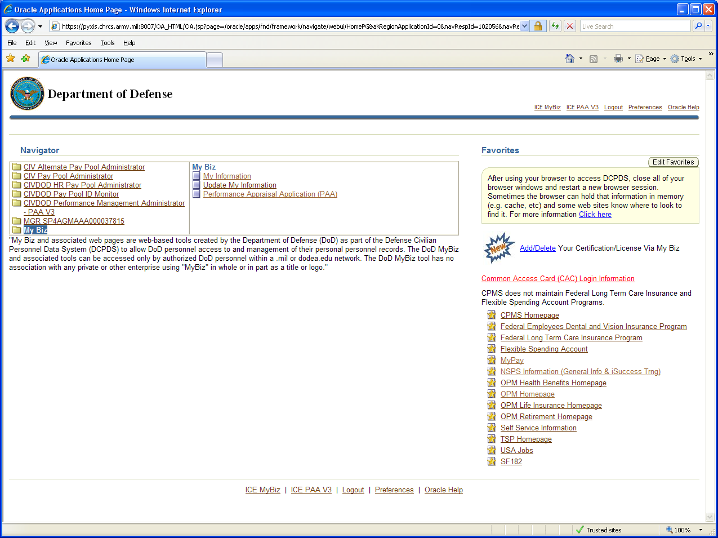
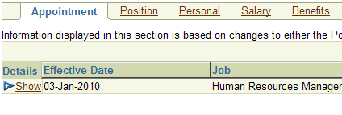
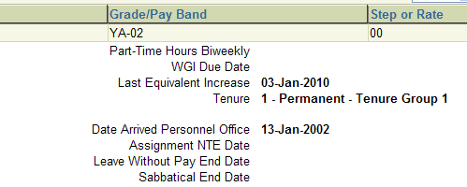
Employee WIGI Information as Shown in “My Biz”

Slide 17
KEY POINTS
Employees will not lose pay upon transition
DCIPS employees’ salaries will be aligned to a grade and step; pay may stay the same or increase to align to a step

Slide 18
TRANSITION IMPACT
ON DCIPS
PERFORMANCE MANAGEMENT

Slide 19
KEY POINTS
DCIPS performance management system will remain in tact with only minimal change
  DCIPS employees being aligned to a new work level are REQUIRED to complete a DCIPS closeout performance evaluation immediately preceding transition to document and closeout performance under the previous work level. NO ACTION needed for those not changing work levels other than a midpoint review which is due at the same time as transition.
Objectives will continue to be set to work levels and performance-based bonuses will continue to be based on work levels and not grades
Employees will continue to be rated against the same performance elements

Slide 20
TRANSITION IMPACT
ON DCIPS
EMPLOYMENT AND PLACEMENT

Slide 21
KEY POINTS
New “DCIPS Employment and Placement,” Policy (AP-V 2005)
  New procedures for processing 30% veteran preference pass over
  Eliminates reference to Interchange Agreement
  Provides for term appointments of no more than 5 years
  Enhanced Adjustment in Force (AIF) procedures
  Clarifies position coverage
    Occupational: Positions engaged in intelligence and related work (requiring a significant degree of specialized intelligence KSA’s) in non-intelligence commands and activities
    Organizational: Positions in commands and activities that have a primary intelligence mission
    Selected: Positions in direct support of intelligence functions located within non-intelligence commands and activities

Slide 22
TRANSITION IMPACT
ON DCIPS
Adjustment in Force

Slide 23
KEY POINTS
New “DCIPS Adjustment in Force,” policy (AP-V 2004).
  Minimal change. “Adjustment in Force (AIF)” rather than “Reduction in Force (RIF)”.
  What Doesn’t Change:
    DCIPS stresses placement rather than displacement.
    DCIPS and Competitive Service employees do not compete against each other during an AIF. A Competitive Service employee cannot bump or retreat into a position encumbered by a DCIPS employee and vice versa.
    Only one round of competition in an AIF because of how Assignment Rights are determined.
    DCIPS employees do not have “Assignment Rights” that result in chain reactions where one displaced employee displaces another who displaces another, etc. Instead, if a position is abolished, no more than two people will be impacted – the person in the position to be abolished and the person on the applicable Retention Register with the lowest retention, if different from the first person. The lowest person on the Retention Register is the one who will be displaced.

Slide 24
TRANSITION IMPACT
ON DCIPS
Awards and Recognition

Slide 25
KEY POINTS
New DCIPS Awards and Recognition (AP-V 2008) Policy
  Quality Step Increase (QSI) replaced by:
    DCIPS Quality Increase (DQI)
    DCIPS Sustained Quality Increase (DCIPS SQI)

Slide 26
KEY POINTS
DCIPS Quality Increase (DQI). DQI is a base pay increase monetary award in the form of an increase in an employee’s pay from one step of the grade of his or her position to the next higher step of that grade. Commands may use a DQI to reward Army DCIPS employees with a current evaluation of record of “Outstanding” and who have not received a base-pay increase monetary award of any type within the preceding 52 consecutive weeks. Command discretion may be used to provide additional criteria for this award.

Slide 27
KEY POINTS
DCIPS Sustained Quality Increase (DCIPS SQI). DCIPS SQI provides the highest base-pay increase monetary award available to Army DCIPS employees. The DCIPS SQI is a sustained performance award reserved to recognize truly exemplary sustained performance. The award consists of a base pay increase monetary award in the form of an increase in an employee’s pay of two steps at their current grade. Commands may use the SQI to reward employees who received “Outstanding” evaluations of record for three consecutive years, the current and two preceding performance evaluation cycles. Employees considered for this award must have been under the DCIPS Performance Management system and in the same DCIPS grade for the last three years

Slide 28
TRANSITION IMPACT
ON DCIPS
DISCIPLINARY, PERFORMANCE-BASED, AND ADVERSE ACTIONS

Slide 29
KEY POINTS
New DCIPS Disciplinary, Performance-Based, and Adverse Action Procedures (AP-V 2009)
  Establishes a non-preference eligible Army DCIPS appeals process [replaces administrative grievance rights for non-preference eligible Army DCIPS employees initiated under AP-V 2009 & DoDI 1400.25-V2009]
  Establishes policy and procedures on “Special Termination Authority” under the conditions specified in section 1609, title 10, U.S.C
    DCIPS disciplinary, performance-based, and adverse actions will continue to be taken to promote the efficiency of the Army DCIPS workforce, in the event of unacceptable performance or misconduct

Slide 30
TRANSITION IMPACT
ON DCIPS
EMPLOYEE GRIEVANCES

Slide 31
KEY POINTS
New “DCIPS Employee Grievance Procedures,” (AP-V 2014) [replaces DoDI 1400.25-SC771 for Army DCIPS employees only]
  Informal and formal processes provided
  Remains for the most part aligned to previous Administrative Grievance Procedures with the exception of “excludable matters” --
    Adverse performance or conduct-based actions [can only be appealed IAW AP-V 2009]
    Termination of Army DCIPS employee during trial period excluded

Slide 32
Before and After Comparison of DCIPS Transition
What critical changes resulted as a result of transition to grades?
 | Pay Band | Grades
Annual Rating Period | p | p
Official Rating Chain | p | p
Performance Plans | p | p
Ratings | p | p
Bonus Pools | p | P
Performance Payouts | - | -
Reconsideration Process | p | p

Slide 33
Now What?
Interim DCIPS policies and guidance will remain in effect until transition occurs
Await notification of your new alignment to the DCIPS occupational structure
Communicate with your supervisor and internal transition point of contact
Continue with the DCIPS Performance Management cycle [plan, monitor & Develop]; adjusting accordingly if a special DCIPS closeout is required to document performance at a different work level

Slide 34

Additional Training
Thank you for reviewing this online tutorial.
Additional guidance is available on the Army DCIPS website.
Look for more DCIPS training tutorials on the DCIPS Training web page.

